Slide 1
Electronics & Electricity
Unit 7 – Testing a capacitor
Section 2 – testing a capacitor

Slide 2
Testing A Capacitor
Testing a capacitor

Slide 3
The big idea
Breadboard circuit prototyping
Circuit schematics
Ohm’s Law application
The Capacitor

Slide 4
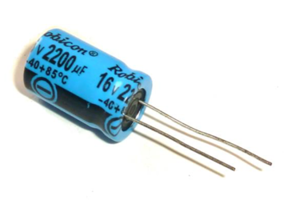
Capacitor

Slide 5
Capacitor
The capacitor is a component that stores energy
Think of it as a small battery with very low capacity
Can be charged and discharged just like a battery
The value of a capacitor is given in F (Farad)
Most of the capacitors you use are in the μF (micro Farad), nF (nano Farad) or pF (pico Farad) range

Slide 6
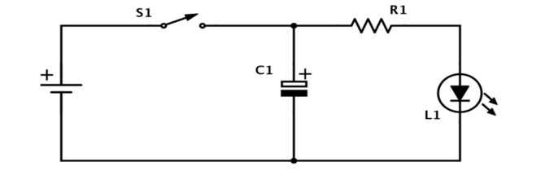
Testing A Capacitor

Slide 7
Testing A Capacitor
When you push the button (S1), the LED lights up and the capacitor starts storing energy. When you release the button (S1), the capacitor discharges through the resistor and LED and you can see the LED fading out.

